Slide 1
Experiments with MATLAB
Google PageRank
Roger Jang (張智星)
CSIE Dept, National Taiwan University, Taiwan
jang@mirlab.org
http://mirlab.org/jang

Slide 2
PageRank Algorithm
Facts about PageRank Algorithm
  Developed by Google’s founders, Larry Page and Sergey Brin, when they were graduate students at Stanford University
  Determined entirely by the link structure of the WWW
  Recomputed about once a month (2004, 4B pages)
  The world’s largest matrix computation (4B bt 4B)
Ideas
  A random walk problem known as Markov chain/process
  Page rank: Limiting probability that a random surfer visits a page
  A page has a high rank if other pages with high ranks link to it.

Slide 3
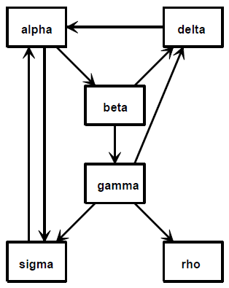
Connectivity Matrix G
Notations
  U: the set of all n web pages in the world (n > 4 billion by June 2004)
  G: the connectivity matrix
    gij = 1 if there is a hyperlink to page i from page j
    gij = 0 when i=j.
Facts
  G is huge, but very sparse (50 links for my webpage.)
  No. of nonzeros in G is the no. of hyperlinks in U.
1
4
2
3
Equivalent!
Equivalent!
6
5
Quiz!

Slide 4
Degrees of a Page
1
4
Degrees of a page
  Define row and column sums of G:
  ri: in-degree of page I
    Row sum of G
  cj: out-degree of page j
    Column sum of G
2
3
6
5

Slide 5
From Connectivity Matrix to
Transition Probability Matrix
Connectivity matrix
  G: gij = 1 if there is a hyperlink from page j to i
Transition prob. Matrix
  A: aij the prob. of moving from page j to I by link following
1
4
2
3
6
5
Hint: Column j is the prob. of
Jumping from page j to others.

Slide 6
Two Types of Transitions
Type 1: Follow one of the links (with prob. p)
Type 2: Jump to a random page (with prob. 1-p)
p
0
p
1-p
1
1-p
Basic concept:
Actual formula:
Column sum
always equals 1!

Slide 7
Transition Probability Matrix
Quiz!
Facts
  A is a Markov matrix (stochastic matrix )
    Each column is a stochastic vector with non-negative elements and column sum equal to 1
    A is regular iff no element is zero ➔ We shall assume A is a regular Markov matrix for the subsequent discussion.
  If z is the initial prob. on each page, Az is the prob after 1 transition, A²z is the prob after 2 transitions, …
  A^{k}z converges to the page rank if k is big.
  A^{k+1}z= A^{k}z when k is big ➔ Ax=x, with x= A^{k}z when k is big ➔ x is Google’s PageRank.
  Most of the elements of A are equal to (1-p)/n.
    If n=4*10⁹ and p=0.85, then (1-p)/n=3.75*10⁻¹¹.
A^{k}z is always a stochastic vector!

Slide 8
Example of Markov Matrices
A=[0.8 0.4; 0.2 0.6] is a regular Markov matrix
  A¹⁰=[0.67 0.67; 0.33 0.33] ➔ Converged
B=[0 1; 1 0] is not regular
  B¹⁰=[1 0; 0 1], B¹¹=[0 1; 1 0] ➔ Not converged

Slide 9
How to Compute PageRank
Quiz!
Eigenvector method
  A*x=x ➔ x is the eigenvector corresponding to eigenvalue 1
  Fact 1
    A always has 1 as its eigenvalue of max magnitude
Power method
  Repeat x=A*x until x converges
  The only possible approach for a large n
  Fact 2
    A^{k}z is not affected by z as k increases
50~100 iterations when n=4B.

Slide 10
Prerequisites for Consequent Proof
Column sum & row sum
  Column sum of A = sum(A) = [1 1 1]*A
  Row sum of A = sum(A, 2) = A*[1 1 1]^{T}
A and A^{T} have the same eigenvalues
Quiz!
But not necessarily the same eigenvectors!

Slide 11
Prerequisites for Consequent Proof
Suppose that z₁, z₂, and z₃ are complex numbers, we have the following identities:
Triangle inequality!
Quiz!

Slide 12
Fact 1a: Proof
Quiz!
A always has an eigenvalue of 1
  Since the column sum of A is an all-1 vector, A^{T} has 1 as its eigenvalue:
  So 1 is also an eigenvalue of A since
Column sum!

Slide 13
Fact 1a: Another Proof
Quiz!
Extension: If each column sum of matrix A equals k ➔ k is a eigenvalue of A.

Slide 14
Quick Summary
Quiz!
If each row sum of matrix A is k, then
  k is a eigenvalue of A, with an eigenvector of all 1’s.
If each column sum of matrix A is k, then
  k is a eigenvalue of A. (But we don’t know about its eigenvector.)

Slide 15
Quiz Candidates
Quiz!
What can you infer about the eigenvalues and eigenvectors of the following matrix A?
  A=magic(3)
    ➔ eigvalue=15, eigenvector=[1 1 1]^{T}
  A=magic(3)+[1 2 3]’*ones(1,3)
    ➔ eigvalue=21
  A=magic(3)+ones(3,1)*[1 2 3]
    ➔ eigvalue=21, eigenvector=[1 1 1]^{T}

Slide 16
Fact 1b: Proof
A has 1 as its eigenvalue of max magnitude
  Proof (ref)
Fact: A and A^{T} has
the same eigenvalues!
Reminder: λ and x_{i}
could be complex!
Quiz!

Slide 17
Eigenvalue Decomposition
Recap on eigenvalue decomposition
Similar transform!
Quiz!

Slide 18
Fact 2: Proof
A^{k}z approaches the page rank as long as k is big enough and z sums to 1.
In fact, A^{k} approaches a matrix
of same columns (the PageRank) when k is big!
Normalizing factor only,
independent of z
Sum to 1!

Slide 19
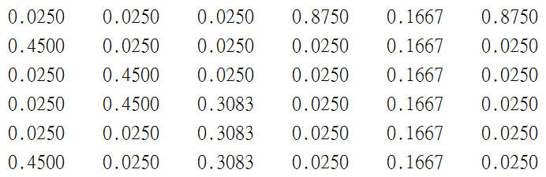
Example of Tiny Web
A tiny web
Transition matrix A
When p=0.85, we have the page rank (via pagerank.m):
1
4
2
3
6
5
Check page importance by in-degrees!

Slide 20
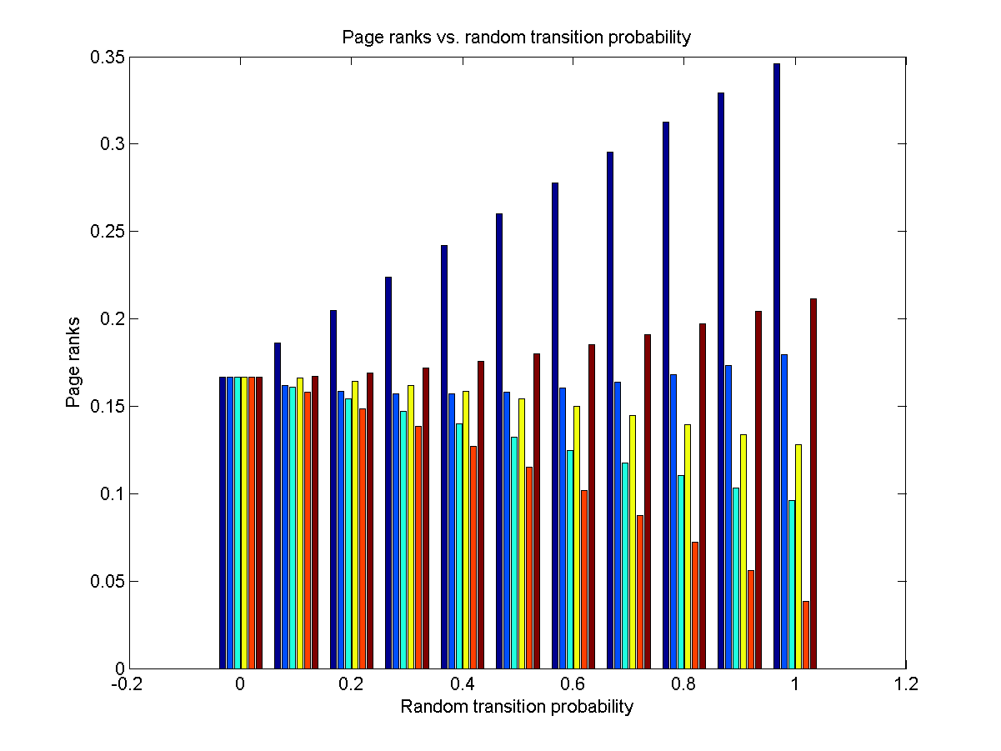
Example: Page Rank vs. P
P: the prob. of following a link in a page

Slide 21
Application Scenarios
Applications of PageRank (Try “pagerank applications” in Google)
  Team ranking in a sport
    Eigenvalue decomposition for soccer games
  University ranking
    World’s most influential universities
  互推系統
    請互推班上的模範生…
  Recommendation, journal ranking, food chains, molecular interactions, lung cancers, …
How to boost your pagerank?
How about “班上互推劣等生”?

Slide 22
Exercise
If A=[0.6 0.8; 0.4 0.2], what is its page rank? ➔ [2 1]^{T}/3
If B=[0.8 0.2 0.2; 0.1 0.8 0.2; 0.1 0.0 0.6], what is its page rank? ➔ [4 3 1]^{T}/8

